Slide 1



Week 4, Lecture 8
Forms and Requests with Flask

Slide 2
Admin stuff and reminders:
Don’t forget this week’s discussion topics!
https://login.codingdojo.com/d/309/122/1196
https://login.codingdojo.com/d/309/122/1197
Due Sunday night at 11:59 PM Pacific! Don’t fall behind!!
This week’s core assignments - there are four of them:
Checkerboard
HTML Table
Counter
Dojo Survey
Don’t fall behind on core assignments this week!
Get in touch with your Career Services Manager if you’ve opted in ASAP!!
Please watch the modularization video (to be posted later) before Monday!!
Please respond to the mid-track survey when the email is sent by Friday!

Slide 3
How are you feeling today?
1 = Not good
10 = Very good

Slide 4
Week 4, Lecture 8 agenda:
Overview (and review) of forms
GET vs. POST requests
The HTML form
Grabbing form data in Flask
Redirects
Session

Slide 5
Forms
Where do you see forms?
Logging into a site, searching through Google or a search engine, filling out an online application, etc.
They are ubiquitous! You encounter them all the time!!!
You might recall seeing this at one point in Web Fundamentals:
<form action="/hello" method="POST">
<div>
<label>Name:</label>
<input type="text" name="name">
</div>
<input type="submit" value="Send">
</form>
The bold text is going to be VERY important!!

Slide 6
Question 1
List a few examples of GET requests and at least one example of a POST request.

Slide 7
Question 1
List a few examples of GET requests and at least one example of a POST request.
Answer:
GET requests:
Clicking a link
Entering a link in the browser
Refreshing a page
Redirecting (coming later this lecture!)
POST requests:
Sending sensitive data through forms, like logging in or registering
Most search requests
Nearly everything involving a form

Slide 8
Demo of GET vs. POST requests
Notes:
Note: try creating a form WITHOUT method=”POST” first and see what you get in the URL.

Slide 9
GET vs. POST requests
The two most common types of HTTP requests are GET and POST requests:
GET requests are used to receive data or some other information, such as an HTML page or a JSON object.
POST requests are used for sending information, like posting (i.e. sending) a parcel at a post office. POST requests are used for most forms.
There are other HTTP request types as well: PUT, DELETE, PATCH, among others. (More information can be found here: https://developer.mozilla.org/en-US/docs/Web/HTTP/Methods.)
(Unfortunately, HTML tags only support GET and POST methods, and Jinja doesn’t have any functionality to force a request to be a PUT or DELETE request. If you want to use PUT and DELETE requests, you need AJAX.)

Slide 10
Question 2
Fill in the missing pieces in this to make this a form where data can be sent to a POST route named “/add_user”.
<form> <!-- Part A -->
<div>
<label>Name:</label>
<input type="text"> <!-- Part B -->
</div>
<div>
<label>Email:</label>
<input type="text"> <!-- Part C -->
</div>
<div>
<label>Password:</label>
<input type="password"> <!-- Part D -->
</div>
<input type="submit" value="Send">
</form>

Slide 11
Question 2
Fill in the missing pieces in this to make this a form where data can be sent to a POST route named “/add_user”.
ANSWER:
<form action="/add_user" method="POST"> <!-- Part A -->
<div>
<label>Name:</label>
<input type="text" name="name"> <!-- Part B -->
</div>
<div>
<label>Email:</label>
<input type="text" name="email"> <!-- Part C -->
</div>
<div>
<label>Password:</label>
<input type="password" name="password"> <!-- Part D -->
</div>
<input type="submit" value="Send">
</form>
You can use whatever value you want for the name attribute in each.

Slide 12
Creating a form
Forms take on much more significance now compared to what you learned about them in Web Fundamentals!
Here is what an HTML form will look like:
<form action="/route/to/send/data/to" method="POST">
<div>
<label>Favorite word:</label>
<input type="text" name="word">
</div>
<input type="submit" value="Send">
</form>
action: The route you will send the data to (don’t forget the leading “/”)
method: Needed to make this a POST request; otherwise if it’s not mentioned, the form will be sent as a GET request by default
ALL HTML tags that have something you can fill out, like <input>, <textarea>, etc. need a name attribute that defines a variable that will hold the value
Need a <button> or <input type="submit"> to submit the data

Slide 13
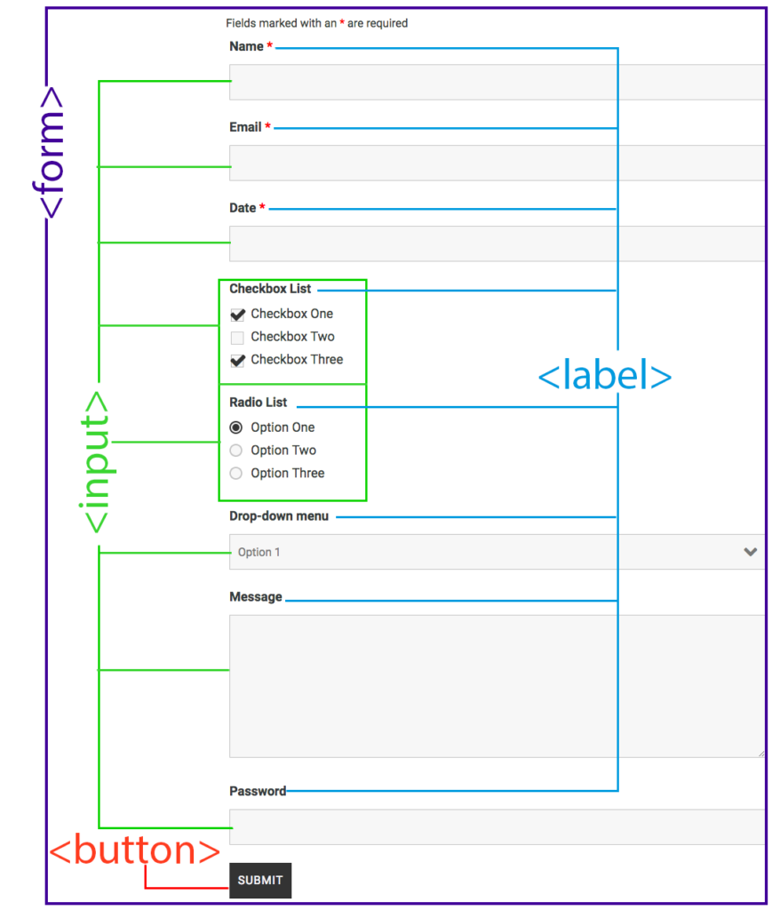
Anatomy of a Form

Slide 14
Question 3
Here is the “/add_user” method in the server.py (later on, future controller file). Fill in the missing pieces. (Don’t worry about importing commands.)
@app.route("/add_user") # Part A
def create_user():
# Print the name and password here
print() # Part B - print the name from the form
print() # Part C - print the email from the form
pass # We will return something in a bit (see next question)!

Slide 15
Question 3
Here is the “/add_user” method in the server.py (later on, future controller file). Fill in the missing pieces.
ANSWER:
# Do NOT confuse this with method="POST" in the HTML!
@app.route("/add_user", methods=["POST"])
def create_user():
# Print the name and password here
print(request.form["name"]) # You have to match your names EXACTLY!
print(request.form["email"])
pass
At the top of the server.py file:
from flask import request

Slide 16
Demo of sending and
retrieving form data
Notes:
Note: try creating a form WITHOUT method=”POST” first and see what you get in the URL.

Slide 17
Grabbing data sent via the form
Remember to import request in your file!
from flask import request
In your route:
@app.route("/route/to/send/data/to", methods=["POST"])
def handle_data():
print(request.form) # request.form is a dictionary
print(request.form["word"]) # print value linked to input with name="word"
pass # Will replace this in the next few slides!
Use request.form["variable_from_name_in_HTML"] to grab data from the form!
NOTE: Even for input types like number and date, you get a string back!!! So you need to convert accordingly if needed, so int() for example to convert to an integer.
IMPORTANT: Whatever you used for the name attribute in your inputs in the HTML file MUST match EXACTLY the spelling of the key inside the quotes when using request.form! Also make sure your route names match!!

Slide 18
Grabbing data sent via the form
IMPORTANT: Whatever you used for the name attribute in your inputs in the HTML file MUST match EXACTLY the spelling of the key inside the quotes when using request.form! Also make sure your route names match!!
In your route:
@app.route("/route/to/send/data/to", methods=["POST"])
def handle_data():
print(request.form) # request.form is a dictionary
print(request.form["word"])
pass # Will replace this in the next few slides!
In the HTML:
<form action="/route/to/send/data/to" method="POST">
<div>
<label>Favorite word:</label>
<input type="text" name="word">
</div>
<input type="submit" value="Send">
</form>

Slide 19
Question 4
Here is the add_user route again. Replace the line that has “pass” with code that sends someone to a new route called “/new_user_page”. (Don’t worry about importing commands for this question.)
# Do NOT confuse this with method="POST" in the HTML!
@app.route("/add_user", methods=["POST"])
def create_user():
# Print the name and password here
print(request.form["name"]) # You have to match your names EXACTLY!
print(request.form["email"])
pass # Replace this line

Slide 20
Question 4
Here is the add_user route again. Replace the line that has “pass” with code that sends someone to a new route called “/new_user_page”. (Don’t worry about importing commands for this question.)
ANSWER:
# Do NOT confuse this with method="POST" in the HTML!
@app.route("/add_user", methods=["POST"])
def create_user():
# Print the name and password here
print(request.form["name"]) # You have to match your names EXACTLY!
print(request.form["email"])
return redirect("/new_user_page") # ALWAYS redirect with POST requests!!
In your file, don’t forget to import redirect from flask!
from flask import redirect

Slide 21
Demo of redirects and what happens to form data
Notes:
Note: demo what happens with POST request.form data if you didn’t redirect and you refreshed the page instead

Slide 22
Redirects
At some point, you’ve likely encountered a message saying you’re being redirected to another page, especially when you visit a page that’s more or less dead. Redirects are used to go from one route directly to another.
In your app, remember to import redirect!
from flask import redirect
IMPORTANT: ALWAYS redirect when dealing with POST requests!
@app.route("/route/to/send/data/to", methods=["POST"])
def handle_data():
print(request.form) # request.form is a dictionary
print(request.form["word"])
return redirect("/route/to/redirect/to") # ALWAYS redirect to a route!!
What happens to request.form after redirecting? The form data disappears because you have made a new (GET) request by redirecting to another route!

Slide 23
render_template
vs.
redirect:
When do you use them?
render_template will ALWAYS be used to display an HTML document to the browser.
redirect will be used to change the page due to an if statement or when a hidden route is being used like when you post data to the database. ALWAYS redirect to a route, NEVER to an HTML page!
POST (creating), UPDATE, DELETE functions will ALWAYS use a redirect.

Slide 24
Session
What is session used for?
Session is used to hold data across multiple routes. Whenever you send data with a form to a route that processes it, you then redirect to a new route. When you redirect, that form data disappears because a new request was made to the new route.
For example, if you submit POSTed data to a route called “/add_book”, and then redirect to the route called “/books” that lists all the books you have, the form data will go away the moment you redirect to the “/books” route.
This is one application for session. Another will be when you keep track of who’s logged in. There will be other uses for session as well.
Try not to use session to hold sensitive data as it’s not incredibly secure.

Slide 25
Demo of session
Notes:
Note: demo of a minproject that requires session - keeping track of values being added together; has a mock “log-in” page as well

Slide 26
Session
To utilize session, you need to import it AND create a secret key.
from flask import Flask, session # add additional methods you need here
app = Flask(__name__)
app.secret_key = "your_secret_key_here"
Create a session variable called “key_name”: session["key_name"] = value
Do NOT use session to hold OOP class instances, like an instance of a User.
Delete a session variable (there are other ways): session.pop("key_name")
Clear a session completely: session.clear()
You can access session values in the HTML:
{{ session["key_name"] }}
You do NOT need to pass session variables in the render_template method.

Slide 27
Please watch the modularization video this weekend! When we meet next lecture, we will start with a project ALREADY modularized.
Notes:
Note: try creating a form WITHOUT method=”POST” first and see what you get in the URL.

Slide 28
Bonus/group exercises: Python and MySQL review
Notes:
Note: try creating a form WITHOUT method=”POST” first and see what you get in the URL.

Slide 29
Lists of dictionaries
Here is a sample list of dictionaries:
directors_list = [
{
"id": 1,
"first_name": "Steven",
"last_name": "Spielberg",
"birthdate": "1946-12-18"
},
{
"id": 2,
"first_name": "Alfred",
"last_name": "Hitchcock",
"birthdate": "1899-08-13"
},
]
Write a loop that prints each director in this format:
Director #1 is Steven Spielberg, born on 1946-12-18

Slide 30
Lists of dictionaries
Solution:
for director in directors_list:
# Note: the print statement is all one line below actually
print(f'Director #{director["id"]} is {director["first_name"]} {director["last_name"]}, born on {director["birthdate"]}')

Slide 31
Lists of class instances
Suppose we have defined a class of directors like so:
class Director:
def __init__(self, data): # data is a dictionary from our database!
self.id = data["id"]
self.first_name = data["first_name"]
self.last_name = data["last_name"]
self.birthdate = data["birthdate"]
self.movies = [] # Placeholder to hold Movies
Now write a loop that does the same thing as the previous exercise - that is, print each director in this format:
Director #1 is Steven Spielberg, born on 1946-12-18
Assume each Director (note the capitalization for class name!) is stored in a list called “directors_list”, where each item is a Director instance.

Slide 32
Lists of class instances
Solution:
for director in directors_list:
# Note: the print statement is all one line below actually
print(f'Director #{director.id} is {director.first_name} {director.last_name}, born on {director.birthdate}')
Notice the periods (dots) for class instances vs. the brackets for dictionaries: director.id and NOT director["id"]
You’ll be doing something pretty similar to this A LOT in your HTML files!!

Slide 33
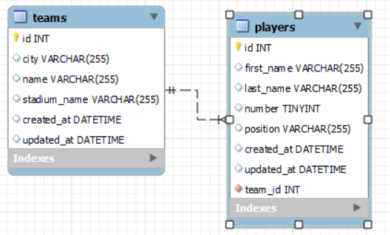
SQL review
Here is a picture of an ERD with teams and players (using any sport you want), using a one-to-many relationship. You can use a different ERD for these exercises if you want, as long as there is a foreign key like team_id.

Slide 34
SQL review
Regardless of which ERD you use, make sure you practice CRUD queries and JOIN statements (LEFT JOIN vs. JOIN)! These are exercises to keep your skills fresh. (No solutions will be given here to encourage you to practice.)
Add at least 3 teams.
Add at least 2 players. Make sure you’ve created teams first!!
Grab all the teams without their players.
Grab all the teams WITH their players - make sure you grab ALL teams, including those without any players!
Grab one team WITH all their players - make sure you grab that team’s information regardless of how many players it has!
Grab one player WITH its team linked.
Edit one of the teams.
Edit one of the players.
Delete a team. (Make sure you can delete teams with players linked and teams that have no players.)

